Slide 1
Behavioral Health for Children and Adolescent Services
DOI Webinar November 9th2020

Slide 5

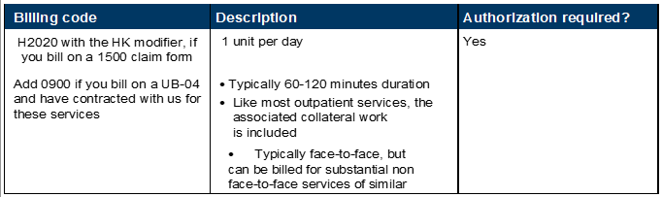

Slide 11
Provider Contracting
All in-network community mental health centers (CMHCs) are contracted for Mobile Crisis Intervention (MCI) and all five Intensive Community Based Treatment (ICBT) services. The CMHC Fee Schedule is found on Provider Central notes the codes, applicable modifiers, and current reimbursement rates.
Code | Modifier | Service | Description
H2011 | N/A | Mobile crisis intervention (MCI) | Crisis Intervention Service
H0023 | HK | Intensive care coordination (ICC) | Behavioral Health Outreach Service (planned approach to reach a targeted population)
H2020 | HK | In-home therapy (IHT) | Therapeutic Behavioral Service
H0040 | HK | In-home behavioral health services (IHBS) | Assertive Community Treatment
H0025 | HK | Family Support and Training (FS&T)
H0046 | HK | Therapeutic Mentoring (TM)
The CMHC network is an open network; all BHCA providers are encouraged to submit the Provider Application as found on Provider Central: https://provider.bluecrossma.com/ProviderHome/myportal/home/office-resources/enrollment/contracting-applications
When submitting the Application, be sure to include the Behavioral Health for Children and Adolescents form for all sites.
All submitted Applications are reviewed to ensure our network CMHCs meet our credentialing standards. Current credentialing policies do not require the individual BHCA sites to be listed on the CMHC license.
Under the CMHC, clinicians are not individually credentialed and contracted and clinicians providing the BHCA or MCI services do not need to be independently licensed. However, clinicians rendering BHCA or MCI services must possess the appropriate training and education and must be supervised by an independently licensed clinician.

Slide 12
Member Eligibility
Mobile Crisis Intervention and Acute Residential Treatment
Both Fully Insured and all Self Insured Accounts provide coverage for Mobile Crisis Intervention and Acute Residential Treatment
Intensive Community Based Treatments
Members <19yr
Fully Insured Accounts starting 7/1/2019 based on the renewal date.
Self Insured Accounts with the option to opt-out starting 1/1/2020 based on the renewal date.
Self Insured Accounts for FS&T and TM are starting 1/1/2021 based on the renewal date.
Self Insured Plans
Self-Insured plans are those in which a large employer takes on full financial risk for providing health care benefits for their employees.
These employers often contract with insurers to administer their claims without taking on any financial risk like with a fully-insured plan.
These plans are regulated entirely by federal law, and are not subject to state mandates.
For that reason, some employers may choose to opt out of certain state requirements, including coverage for BHCA services.
  BCBSMA policy requires these employers to affirmatively opt out to decline this coverage, rather than permitting them to opt into coverage.
It is important for providers to check a patient’s eligibility for BHCA services because their fully-insured or self-insured status will not be apparent from their membership card.

Slide 13
Authorization Process and Requirements
Prior Authorization is NOT required for Mobile Crisis Intervention (MCI) services
The following services are considered outpatient level of care.
Service type | Benefit Level | Copay? | Deductible/ co-insurance? | Prior authorization required?
Mobile Crisis Intervention (MCI) | Outpatient behavioral health | No | Yes (if applicable) | No

Slide 14
Authorization Process and Requirements
Prior Authorization is required for all Acute Residential Treatment (ART) services
We use InterQual medical necessity criteria. To access, log on to bluecrossma.com/provider, and go to Clinical Resources>Prior Authorization>InterQual
Criteria & SmartSheets. Then choose “Intensive Community-Based Treatment” from the CareEnhance Review Manager InterQual drop-down menu.
Please call our Clinical Intake team at 1-800-524-4010 to request the service.
The following services are considered inpatient level of care.
Service type | Benefit Level | Copay? | Deductible/ Co-Insurance? | Prior authorization required?
Intensive community-based acute treatment (ICBAT) | Inpatient behavioral health | No | Yes (if applicable) | Yes
Community-based acute treatment (CBAT) | Inpatient behavioral health | No | Yes (if applicable) | Yes

Slide 15
Authorization Process and Requirements
Prior authorization is required for all Intensive Community Based Treatment (ICBT) services
Only one authorization is required if multiple services are requested by the same provider.
We use InterQual medical necessity criteria. To access, log on to bluecrossma.com/provider, and go to Clinical Resources>Prior Authorization>InterQual Criteria & SmartSheets. Then choose “Intensive Community-Based Treatment” from the CareEnhance Review Manager InterQual drop-down menu.
Please call our Clinical Intake team at 1-800-524-4010 to request the service.
The following services are considered intermediate level of care.
Service type | Benefit Level | Copay? | Deductible/ Co-Insurance? | Prior authorization required?
Intensive care coordination | Outpatient behavioral health | No | Yes (if applicable) | Yes
In-home therapy | Outpatient behavioral health | No | Yes (if applicable) | Yes
In-home behavioral therapy | Outpatient behavioral health | No | Yes (if applicable) | Yes
Therapeutic Mentoring | Outpatient behavioral health | No | Yes (if applicable) | Yes
Family Support and Training | Outpatient behavioral health | No | Yes (if applicable) | Yes

Slide 16
Billing and coding
Service | Definition | Procedure code | Modifier**
Mobile Crisis Intervention (MCI) | Crisis Intervention Service, per 15minutes | H2011 (no limit) | N/A
In-home behavioral health services (IHBS) | Behavior management monitoring and behavior management therapy where the child lives | H0040 (1 unit per day) | HK
In-home therapy (IHT) | Therapeutic clinical intervention and ongoing therapeutic training and support where the child lives | H2020 (1 unit per day) | HK
Intensive care coordination (ICC) | Targeted case management for patients with a serious emotional disturbance; includes assessment, individualized care plan, referral and activities to implement and monitor care plan | H0023 (1 unit per calendar month) | HK
Therapeutic Mentoring |  | H0046 (1 unit per day) | HK
Family Support and Training |  | H0025 (1 unit per day) | HK
Community Based Acute Treatment (CBAT) | Behavioral Health; short term residential (non-hospital residential treatment program), without room and board, per diem | H0018 (1 unit per day) | N/A
Intensive Community-Based Acute Treatment (ICBAT) | Behavioral Health; residential (hospital residential treatment program ), without room and board, per diem | H0017 (1 unit per day) | N/A
**You must include the HK modified on your claim for reimbursement.

Slide 17
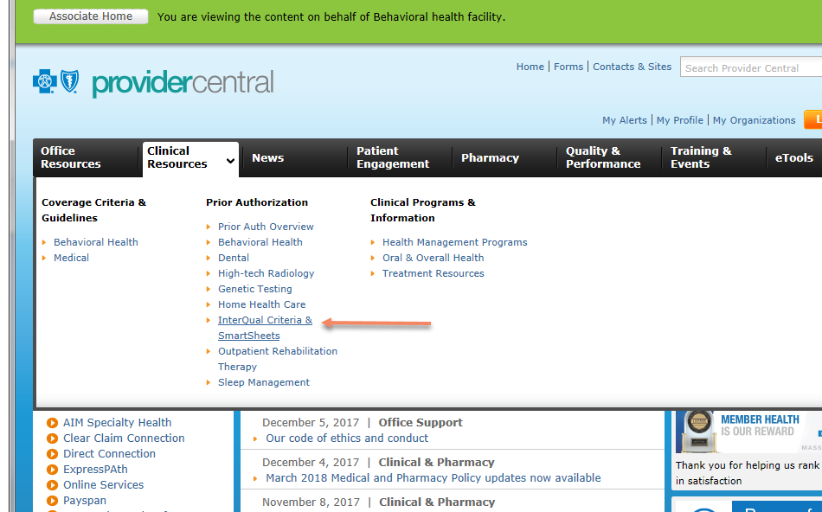
Appendix: Provider Fact Sheet
Questions?
If you have any questions about prior authorization or medical necessity, please call our Clinical Intake team at
1-800-524-4010 to request the service.
Resources
Authorization requirements by product Quick Tip
Community Mental Health Centers payment policy

